Slide 1
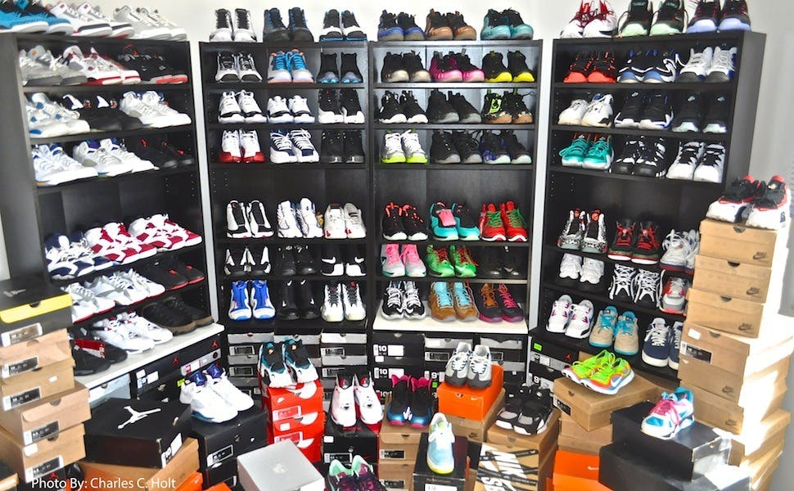
ONLINE FITTING ROOM
EECS 504 Final Project
Shoes for Life : Nam Gyu Kil, Junhwan Kim, Shuoqi Wang, Mu-Ti Chung
Notes:
Hello everybody, thanks for watching this video. We are group “shoes for life”, and we have 4 group members . The name of project is Online Fitting room.

Slide 2
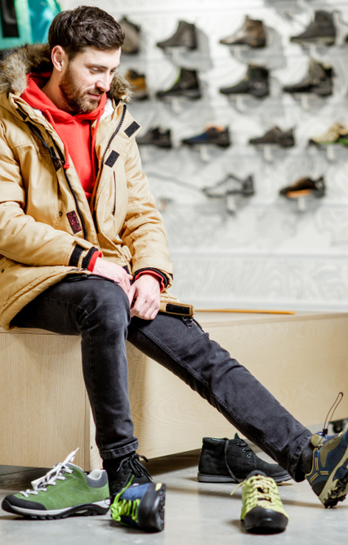
INTRODUCTION
With the outbreak of COVID-19 and stay in home mandates, consumers' clothes and other wearables are accessible through online means. This project aims to help consumers virtually try on products to help facilitate the decision process. Our project will focus on shoes as it is a rigid structure which is much easier to implement than other types of clothes.
Notes:
The idea of this project came from the current social condition. Due to the outbreak of coronavirus, consumer’s cloth and other wearables are mainly accessible through online shopping. The goal of this project is to create an online fitting room to help consumers virtually try on products. And we only focus on shoes because it is a rigid structure.

Slide 3
METHODOLOGY
Input: user daily photos & retailer shoes photos
Output: user photo with the retailer shoes stitched to simulate the actual look
Through object detection and segmentation, a contour of the shoe will be calculated which then can be used to stitch to another photo of the consumer based on the orientation of their feet.
Notes:
To do that, we designed An algorithm which could take user daily photos and multiple orientations of retailer shoes as input, and outputs the original user photo with the retailer shoes stitched at the correct position, angle and scale to simulate the actual look.

Slide 4



IMPLEMENTATION
Detection:
tuning pretrained YOLOv3 detection network
Segmentation: Foreground/background segmentation of the shoes from online retail shops and image of users with shoes.
Image stitching:
shoe orientation alignment and contour point correspondences
Notes:
Our implementation can be divided into 3 steps: detection, segmentation, and image stitching.

Slide 5
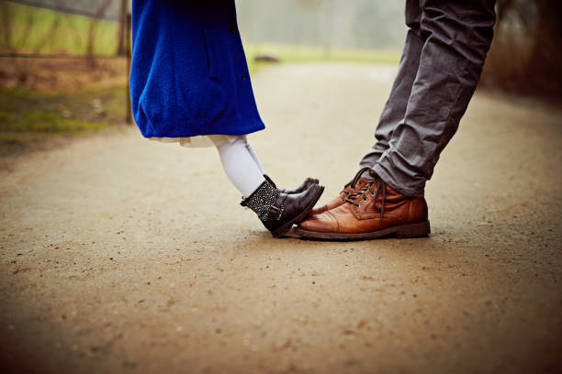
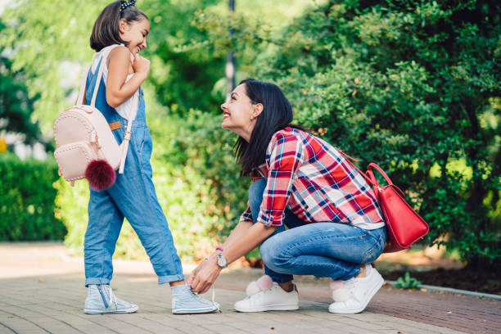
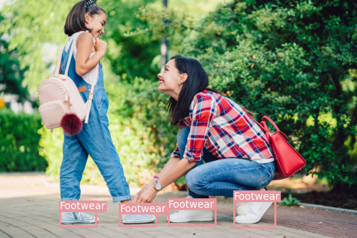
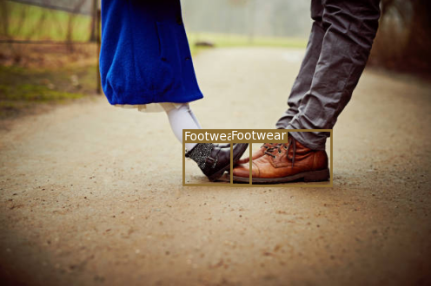
DETECTION
Notes:
The first part of our pipeline is detecting shoes from user-input photos

Slide 6
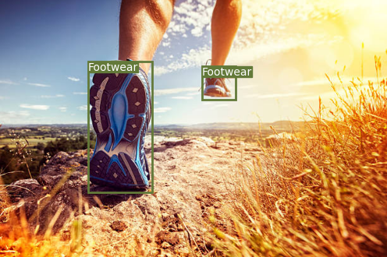
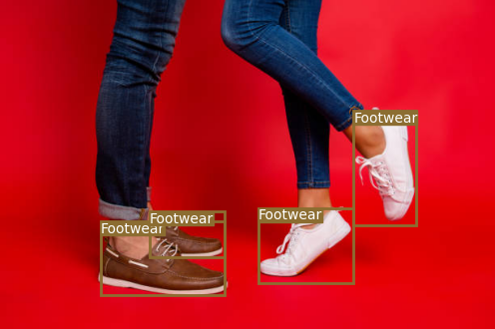
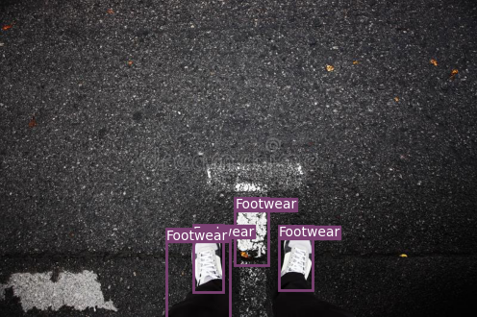
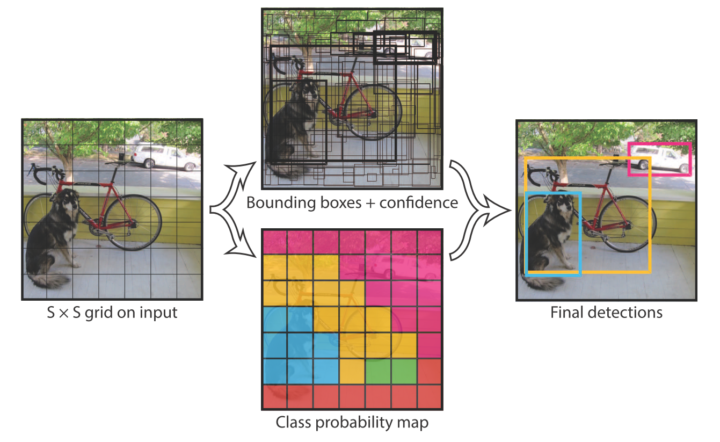
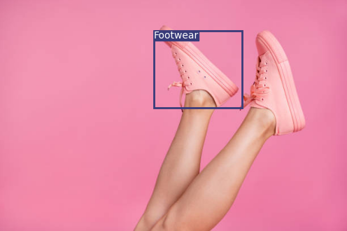
YOLOv3
+
Open Images Dataset V6
+
Tweaks & Filtering
| |
Shoe Detector
Notes:
We chose to utilize the renowned YOLOv3 as our detection network. Initially, we attempted to train our own model for shoes but in vain. Thus, we turned to using the weights pretrained on the Open Images Dataset, which already has a footwear label. With some minor tweaks to the network, our YOLO shoe detector is capable of detecting shoes with arbitrary orientation and scale, and reached an 84% accuracy on our self-collected dataset. Some results are shown on the right. Finally, the model outputs the coordinates of the bounding boxes to the segmentation step.

Slide 7
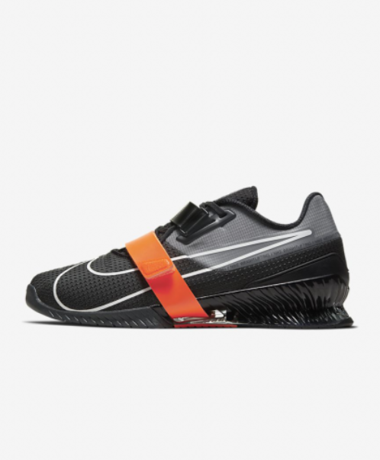
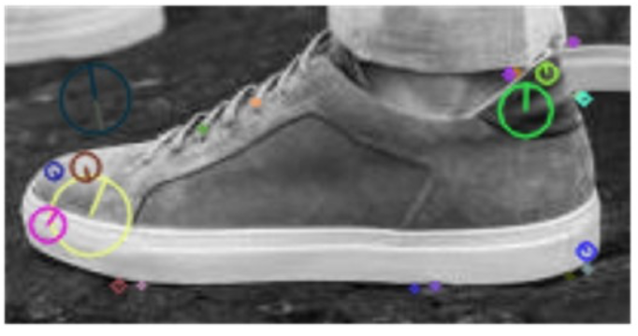
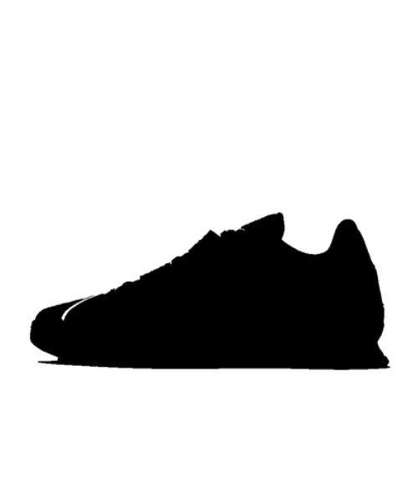
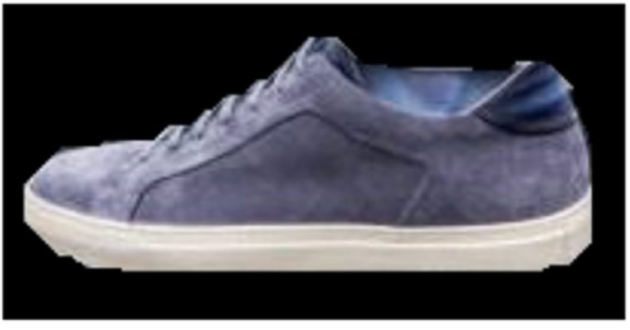
SEGMENTATION
Notes:
The second part of our pipeline was the segmentation of the shoes. In order to properly overlay pictures of shoes from retailer sites onto a user’s picture we need to be able to find the contours of the shoes to correctly align for a natural overlay on top of the user’s photo.

Slide 8
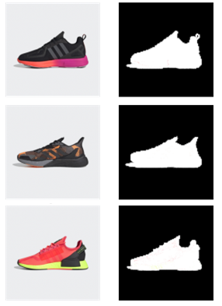
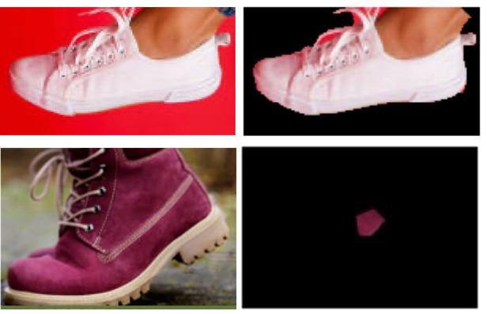
Segmentation: Retail and User
Retail Shoes
User Shoes
Range Map Operation
Ford & Fulkerson
Notes:
To replace the retailer shoe with the user shoes, segmentation must be done on both retail and user shoes.
The retail shoes was the easiest to perform segmentation. As the backgrounds of the picture of the retail shoes were consistent, a simple threshold was applied to create a mask of the retailer shoes as shown in the image on the left.
The user photos were more difficult. Our team had some success with segmentation of foreground and background based on Ford & Fulkerson min cut algorithm, however the results were not consistent. As you can see from the image on the right, the white shoes was able to be properly segmented whereas the red boots were not.
We tuned many variables and experimented with color similarity and proximity values for assigning capacity weights, but the variation of the user photos (foreground and background) made it nearly impossible to produce consistent results for various user photos.

Slide 9
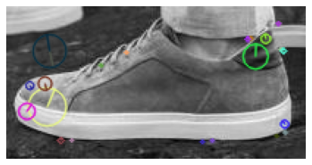
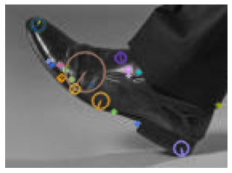
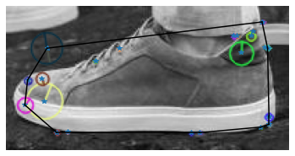
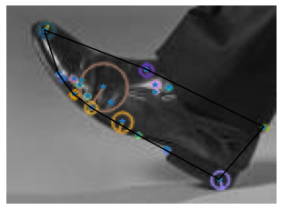
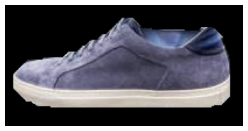
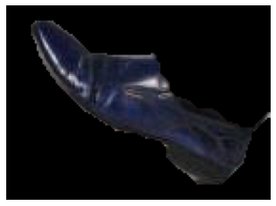
Segmentation Retail Pipeline (Grab Cut)
1. Find SIFT features
2. Find convex polygon enclosing the feature points
3. Using the convex polygon as a mask of probable foreground, run grab cut to segment.
Notes:
As a result, we decided to use another graph cut algorithm slightly more sophisticated than ford fulkerson. The grabcut algorithm uses a Gaussian Mixture Model and Markov Random Field before applying graph cut. However, just using grab cut was not sufficient. Many times using grab cut on user pictures resulted in performance similar to ford fulkerson.
To help the segmentation based on grab cut, we found a rough contour of the user shoes using SIFT feature points and indicated probable foreground for the grab cut algorithm.

Slide 10
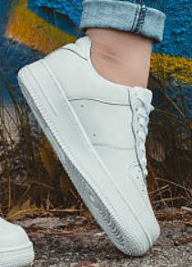
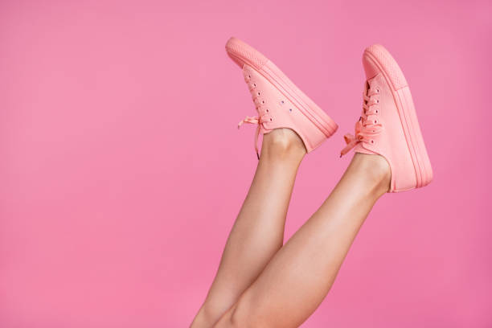
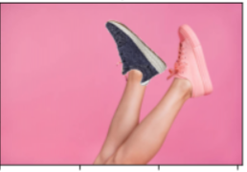
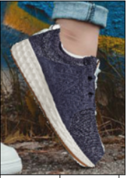
STITCHING
Notes:
The last part of our pipeline is to stitch shoe images together by finding correspondences across shoe segmentations.
//////////////
The third and last of our pipeline is finding feature points correspondences across shoe segmentations and stitching shoe images together.

Slide 11
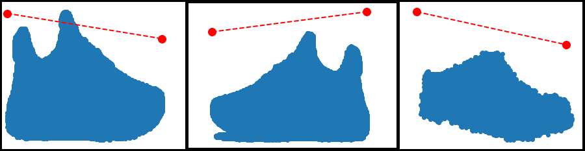
Orientation Matching
Largest eigenvector
Two rotation directions for user shoe
Retail Right
Retail Left
User Shoe
Notes:
To do so, we first perform PCA to find the direction of the largest eigenvector as shown by the red dashed-lines on the slide.
Then we rotate the images such that these eigenvectors are aligned horizontally.
///////////////
To stitch the image of the retail shoe to the user’s shoe, we need to find corresponding feature points between these shoes.
To find these feature points, we first perform PCA on the pixel coordinates in the segmentation map and compute the direction of the largest eigenvector as shown in red dashed-lines on the slide. We then rotate the images such that these eigenvectors are aligned horizontally.
Only specially for the user’s shoe, we rotate the image in both directions to create two orientations, because it is possible the user shoe is upside-down in image such as when the user is running (shown in this image).

Slide 12
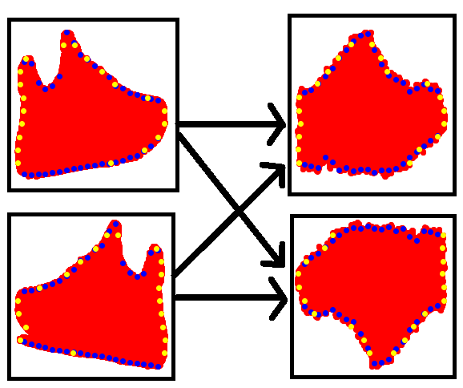
Contour Slicing
Retail Right
Retail Left
User Orientation 1
User Orientation 2
Notes:
Only specially for the user’s shoe, we rotate the image in both directions to create two orientations, as shown by the two images on the right. This way one of these two orientations would have the right side up even if the user’s shoe was originally upside-down or slanted.
So, once the eigenvectors are aligned horizontally as shown by the dashed green lines, we make vertical and horizontal cuts to extract contour points. For each shoe orientation, the contour points from vertical cuts are are shown in blue, whereas ones from horizontal cuts are shown in yellow.
///////////////////////
On the right we can see that the user shoe has create two different orientations. This way at least one of these two orientations would have the right side up even if the original user shoe the shoe started upside-down or slanted.
So, once the eigenvectors are aligned horizontally shown by the dashed green lines, we make vertical and horizontal cuts across the segmentation maps to extract contour points that we will use as our feature points. For each shoe orientation, feature points from vertical cuts are are shown in blue, whereas feature points from horizontal cuts are shown in yellow.
The correspondences between these contour points are made later on such that
contour points from the leftmost vertical cut of one shoe corresponds to the contour points from the leftmost vertical cut of another shoe and so forth.

Slide 13
Transformation Estimation
Retail Left/ Right
User Orientation 1/ 2
Notes:
Now that we have these feature points,
we need to find the transformation that will convert the shape of the retail shoe into the shape of the user’s shoe.
//////////////////////
So now we have the feature points and their correspondences across shoes,
we need to find the transformation that will convert the shape of the retail shoe into the shape of the user’s shoe.

Slide 14
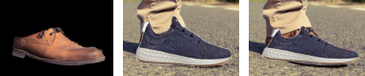
Transformation Types
User Shoe
Similarity
Homography
Notes:
For transformation, we consider both similarity and homography, because while homography provides a more versatile transformation, it can overfit to the dimensions of the user’s shoes. From this slide, we can see that similarity transform produces a better looking results because homography transform vertically scaled down the retail shoe to overfit to the short height of the user shoe.
This leads us to ….
/////////////////
There are two type of transformation we can consider: similarity and homography.
Similarity transform only allow four degrees of freedom: rotation, scale and horizontal and vertical translation,
and homography transform allows eight degrees of freedom. While homography provides a more versatile transformation since it allows higher degree of freedom, it can overfit to width and height differences of the shoes, which can be undesirable at times. From the image shown on the slide, we can see that homography transform vertically scaled down the retailer shoe to overfit to the short height of the occluded shoe.
Hence, one type works better than the other depending on the situation, and we need to consider both options.
This leads to...

Slide 15
Picking the best matching and transformation
(Similarity, Homography) X (Retail Left, Retail Right)
X (User Orientation 1, User Orientation 2)
= 2 X 2 X 2
= 8 options
Notes:
This leads us to having 2 types of transformation, 2 types of retail shoe orientations, and 2 types of user shoe orientations.
a total 8 combinations to consider.
Among these 8 combinations, we pick the best one….
//////////////
This leads to 2 types of transformation, 2 types of retail shoe orientations, and 2 user shoe orientations.
a total 8 combinations to consider when picking the best stitching for a shoe.
How we pick...

Slide 16

Picking the best matching and transformation
1. Similarity
2. Homography
1-1. Maximize number of inliers
1-2. Minimizes least squares error of inliers
2-1. Maximize number of inliers
2-2. Minimizes least squares error of inliers
3. Pick one that covers more of the user shoe when stitched
Notes:
Among these 8 combinations, we pick the best one….
by first picking the best matching among the four similarity transform,
where we maximize the number of inliers returned by the RANSAC algorithm, THEN minimize the least squares error for those inliers.
The best match is shown by the red arrow on the image.
Then we do the same for the homography transform.
Lastly, between these two best options, we pick the one that covers more of the user shoe when stitched.
We use this metric because a good stitching will cover most of the user’s shoe.
///////////////////
How we pick the best transformation and stitching is by using the following algorithm.
First, for similarity transform, we consider the four possible matching between retail and user shoe orientations.
Among those four matchings, we pick the best matching by first maximizing the number of inliers returned by the RANSAC algorithm, THEN by minimizing the least squares error for those inliers. The best matching is shown by the red arrow on the image.
Then we do the same for the homography transform. we find the best matching by first maximizing the number of inliers and then minimizing its least squares error.
Lastly, between these two red arrows, we pick the one that covers more of the user shoe when stitched.
We use this metric because a good stitching will cover most of the user’s shoe.

Slide 17
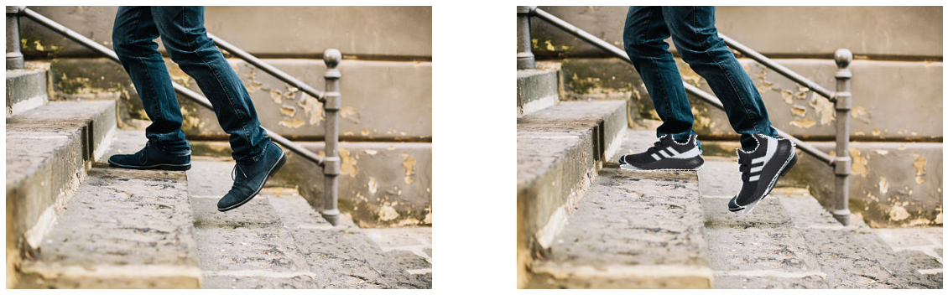
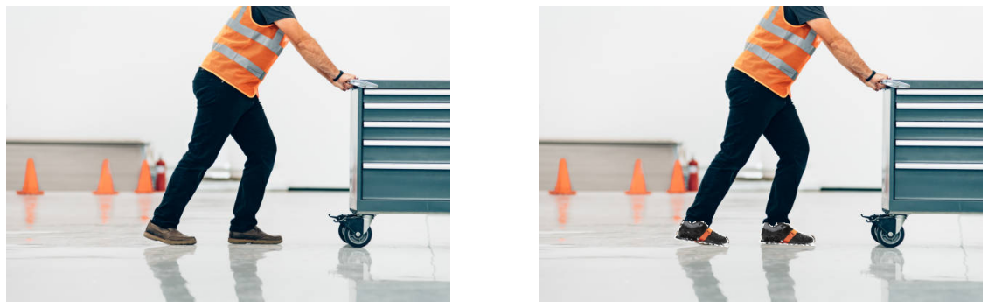
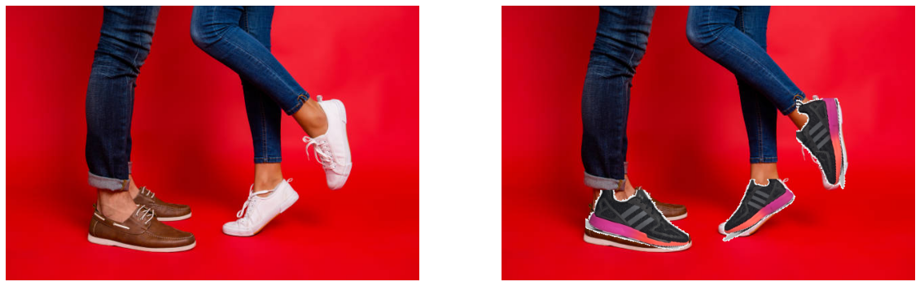
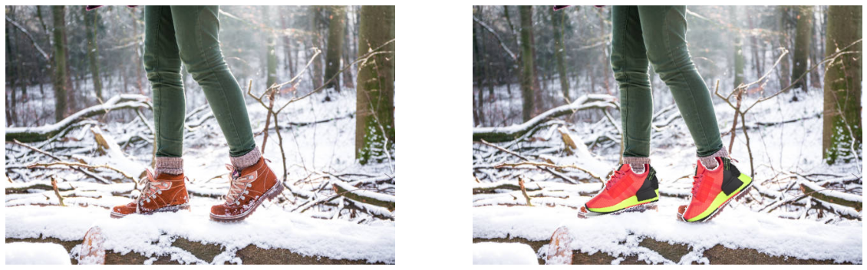
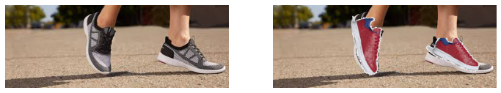
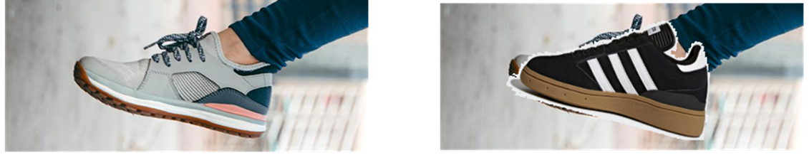
Results
https://colab.research.google.com/drive/1BDjrElvhNqx6gy-
EXkBLg6t6BWGcVXGj?usp=sharing
Notes:
User Photos/left_right_04
and User Photos/right/right_18

